Slide 1



Deep Learning para series temporales
Part I
Introduction

Slide 2
Presentation
Introduction

Slide 3
Proffessors
Víctor Rodríguez Fernández victor.rfernandez@upm.es
María Inmaculada Santamaría Valenzuela mi.santamaria@upm.es

Slide 4
Evaluation
Terminar de plantear, hablamos de evaluar con los torneos del jupyter notebook / entregar / 5 si ejecutan bien el notebook. Entiendo que 1 evaluable por tema

Slide 5
Contents
Part I: Introduction
Why am I here?
Part II: Preprocessing and analysis
ETL + First observations
Part III: Classification
Labelling time series
Part IV: Segmentation & Clustering
Identifying long-term behaviours
Part V: Forecasting
Predicting the future
Part VI: Other Deep Learning tasks
What more can we do?

Slide 6
What are time series?
Identify temporal data

Slide 7

What are time series?
Meals: kilocalories, grams, …
Airport: planes departs, number of passengers waiting
Weather: temperatura readings
Finance: stock prices
Retail: sales data
Sports: goals per minute

Slide 8
A first time series with refill
Time | Available food (gr)
7:00 AM | 200
11:00 AM | 150
03:00 PM | 100
07:00 PM | 50
11:00 PM | 0

Slide 9
A first time series

Slide 10
A first time series with refill
Time | Available food (grs)
7:00 AM | 100
11:00 AM | 50
03:00 PM | 0
06:30 PM | 100
07:00 PM | 50
11:00 PM | 0

Slide 11
A first time series with refill

Slide 12
Stop: What charasteristics makes data be a time series?
?

Slide 13
A first time series
Ordered time sequence
t0 < t1 < t2 < t3 < t4 < t5
Time | Available food (gr)
7:00 AM | 100
11:00 AM | 50
03:00 PM | 0
06:30 PM | 100
07:00 PM | 50
11:00 PM | 0
Time | Data
t0 | Dato (valor real) 1
t1 | Dato 2
t2 | Dato 3
t3 | Dato 4
t4 | Dato 5
t5 | Dato 6

Slide 14
A first time series
Variate to analize
Real values (1, 0.1, -0.27, …)
Time | Cantidad de comida restante (gramos)
7:00 AM | 100
11:00 AM | 50
03:00 PM | 0
06:30 PM | 100
07:00 PM | 50
11:00 PM | 0
Time | Data
t0 | Data 1
t1 | Data 2
t2 | Data 3
t3 | Data 4
t4 | Data 5
t5 | Data 6

Slide 15
A first time series
Each data associated to one timestamp
as an index
Time | Cantidad de comida restante (gramos)
7:00 AM | 100
11:00 AM | 50
03:00 PM | 0
06:30 PM | 100
07:00 PM | 50
11:00 PM | 0
Index | Data
t0 | Dato 1
t1 | Dato 2
t2 | Dato 3
t3 | Dato 4
t4 | Dato 5
t5 | Dato 6

Slide 16
What datatypes in python can we use for storing a time series?
?

Slide 17
Store time series in python
List
Set
Tuple
Dictionary
String
Make a class
Use a predefined widely used class
pandas -> DataFrame

Slide 18
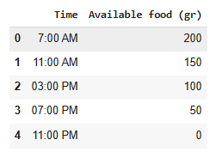
Store time series in python
raw_data_9 = pd.DataFrame({
"Time": ["7:00 AM", "11:00 AM", "3:00 PM", "7:00 PM", "11:00 PM"],
"Available food (gr)": raw_data
})
display(raw_data_9.head())
Index: 0, 1, 2…
Column names: “Time”, “Available food (gr)”
Column values:
“7:00 AM”, “12:00 AM”, …
200, 150, …

Slide 19
Store time series in python
# Index
<pd.DataFrame>.index
# Columns names
<pd.DataFrame>.columns
# Values by column name
<pd.core.series.Series>.values
<pd.DataFrame>[<column name (str)>].values
# Values by column position
<pd.DataFrame>.iloc[:,<column number>].values}")
# Values by row position
raw_data_9.iloc[<row number>, :].values)

Slide 20
Store time series in python
We focus on float data (the most used in time series analysis)
In the next lesson we will see
How to preprocess data (ETL)
How to make the time be the index of the time series

Slide 21
What other time series can we check?
?

Slide 22
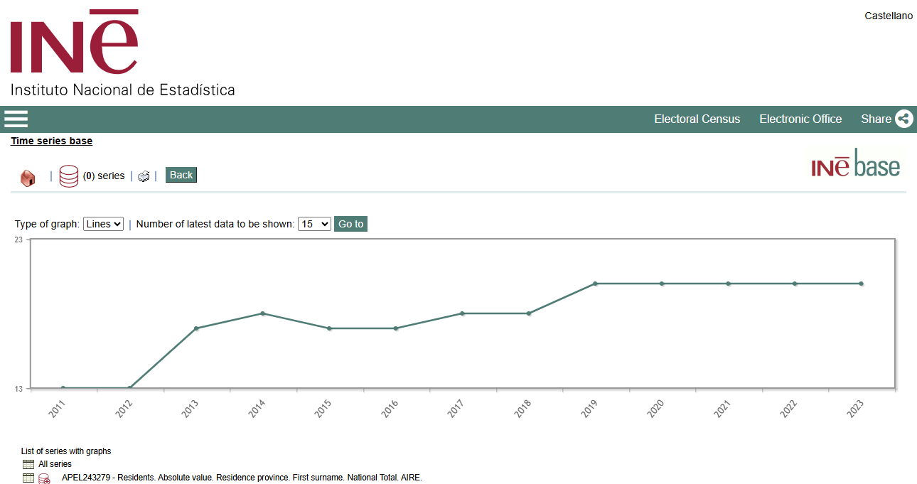
Other time series examples
https://ine.es/consul/serie.do?s=136-243279&L=1

Slide 23
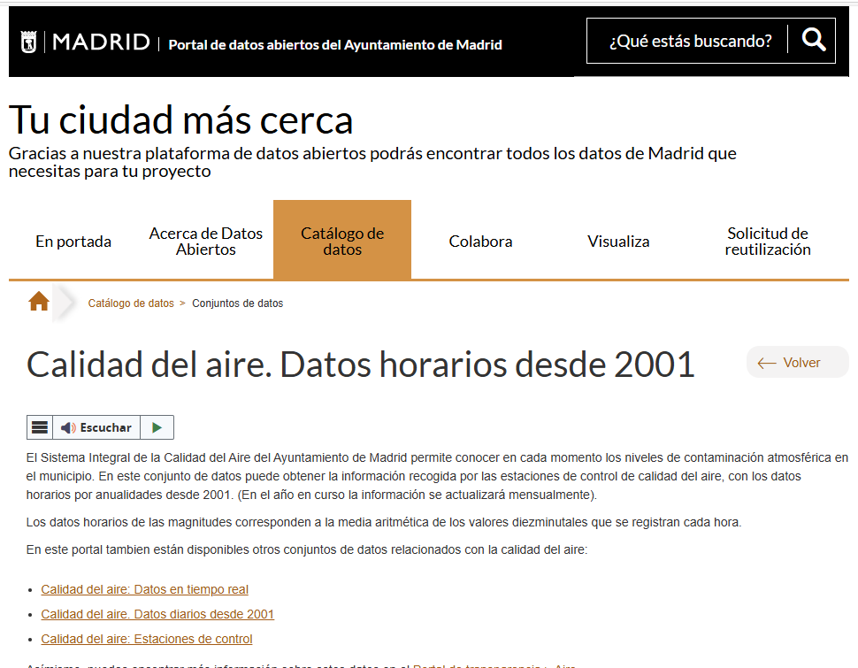
Other time series examples
Calidad del aire. Datos horarios desde 2001 - Portal de datos abiertos del Ayuntamiento de Madrid

Slide 24
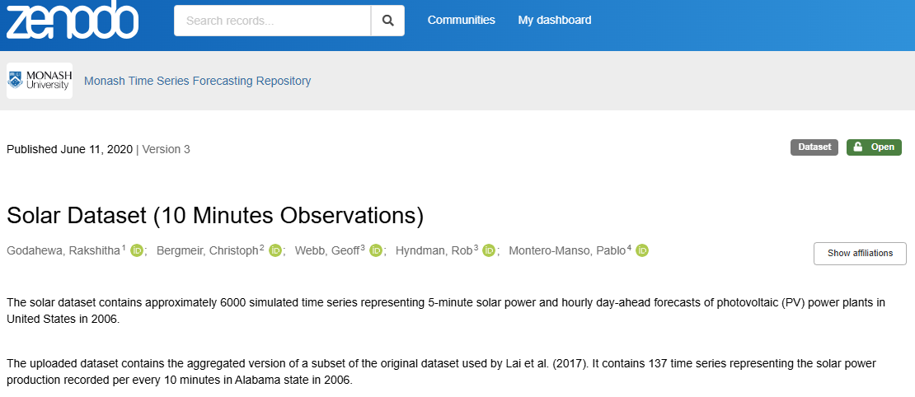
Other time series examples
Solar Dataset (10 Minutes Observations) (zenodo.org)

Slide 25
Other time series examples
Residents / year
https://ine.es/consul/serie.do?s=136-243279&L=1
Air quality data values / hour
Calidad del aire. Datos horarios desde 2001 - Portal de datos abiertos del Ayuntamiento de Madrid
Solar power / 10 minutes
Solar Dataset (10 Minutes Observations) (zenodo.org)
ECG in High Intensity Exercise Dataset
ECG in High Intensity Exercise Dataset (zenodo.org)
Crop yield prediction
Crop Yield Prediction Dataset (kaggle.com)

Slide 26
Applications in your work / real world?
?

Slide 27
Other time series examples
Solved incidences/tickets per hour
Trading
Stock of products in a shop
Available memory / execution time

Slide 28
Real-world uses
Electronic health record (pulsus paradoxus)
Human activity recognition
Cibersecurty
Aerospace engineering
Weather forecasting

Slide 29
How/where can I get data from?
?

Slide 30
Real-world uses
Own data:
Machines
person making actions
smartwatch
Synthetic datasets
Toy (Stumpy): mSTAMP (MSTUMP) Toy Data · TDAmeritrade/stumpy Wiki · GitHub
Databases
Kaggle, Google Dataset Search, Ine, private datasets

Slide 31
A bit of theory
Basic definitions

Slide 32
Number of variates
Univariate (1 feature)
Multivariate (> 1 feature)
Time | Available food (grs)
7:00 AM | 100
11:00 AM | 50
03:00 PM | 0
06:30 PM | 100
07:00 PM | 50
10:00 PM | 0
Time | Refilled food (grs) | Eaten food (grs)
7:00 AM | 100 | 0
11:00 AM | 0 | 50
03:00 PM | 0 | 50
06:30 PM | 100 | 0
07:00 PM | 0 | 50
10:00 PM | 0 | 50

Slide 33
Number of variates
Toy dataset
Tourist number
Tourist Numbers Univariate Forecasting Dataset (kaggle.com)
Index | T1 | T2 | T3
0 | 0.565117 | 0.637180 | 0.741822
1 | 0.493513 | 0.629415 | 0.739731
2 | 0.469350 | 0.539220 | 0.718757
3 | 0.444100 | 0.577670 | 0.730169
4 | 0.373008 | 0.570180 | 0.752406
Date (Unicode format) | Tourist number (total turist number visiting the island)
33604 | 8414
33635 | 9767
33664 | 13805
33695 | 12987
33725 | 32190

Slide 34
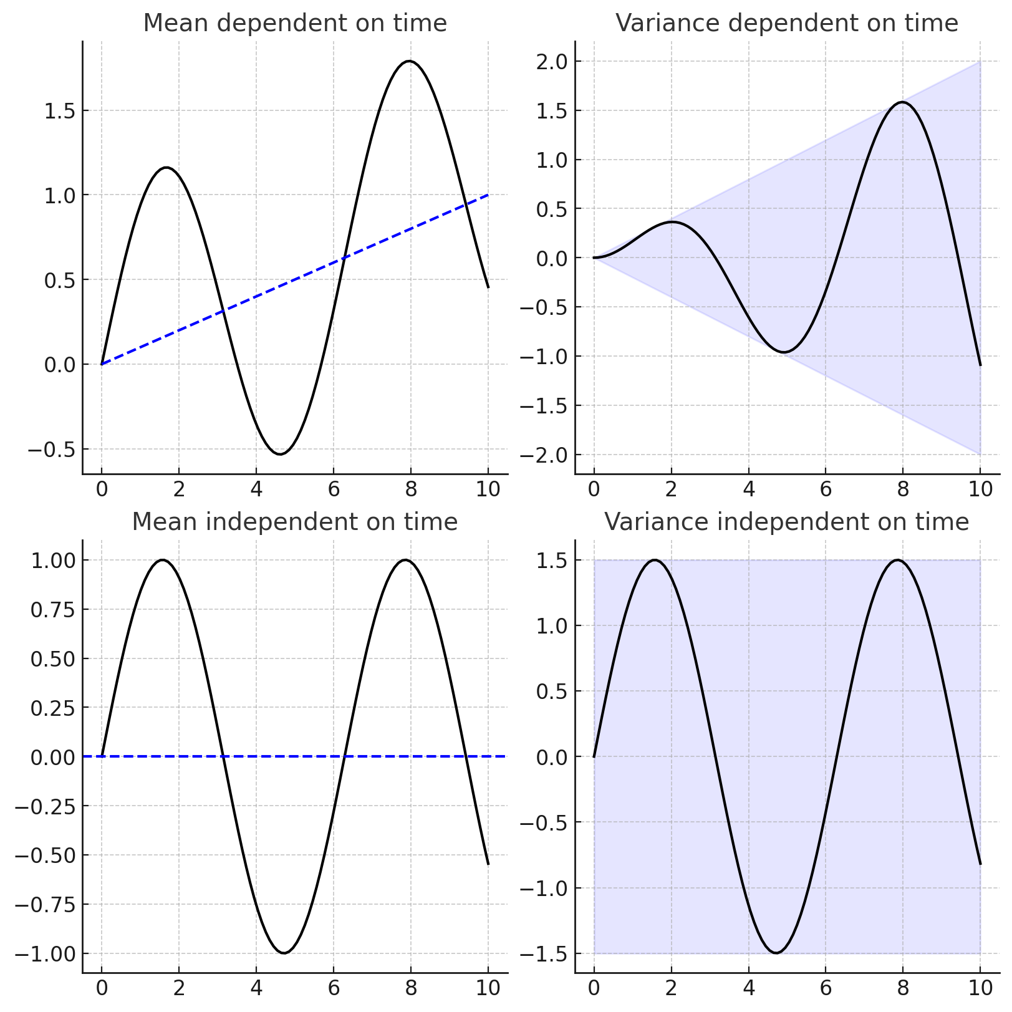
Stationarity
A stationary time series mean and variance doesn’t change.
Notes:
A Gentle Introduction to Time Series Analysis & Forecasting - Weights & Biases (wandb.ai)

Slide 35
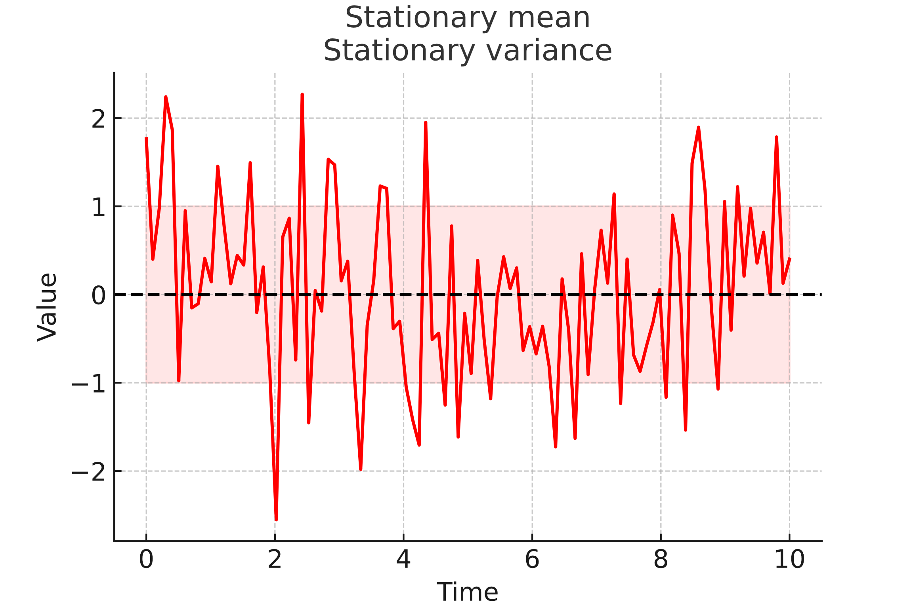
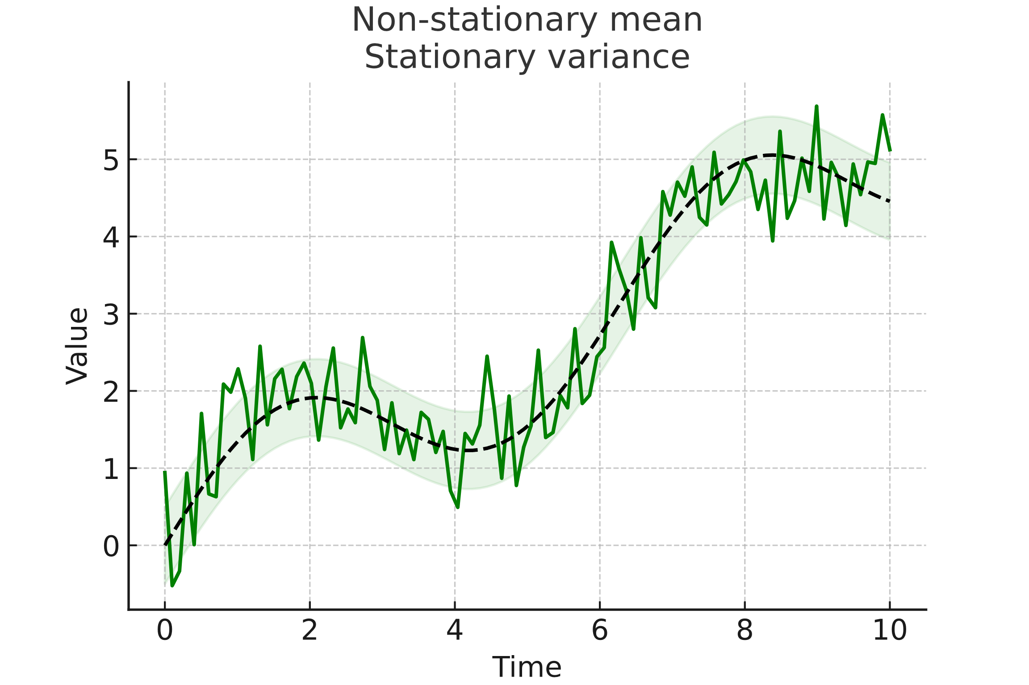
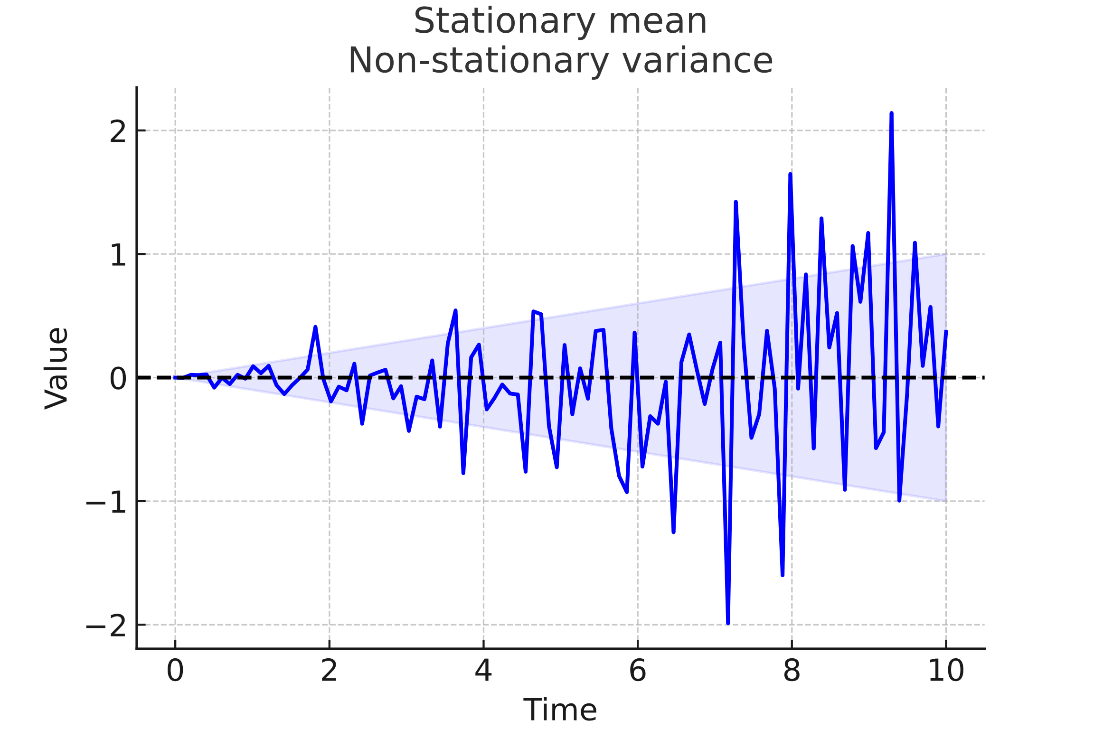
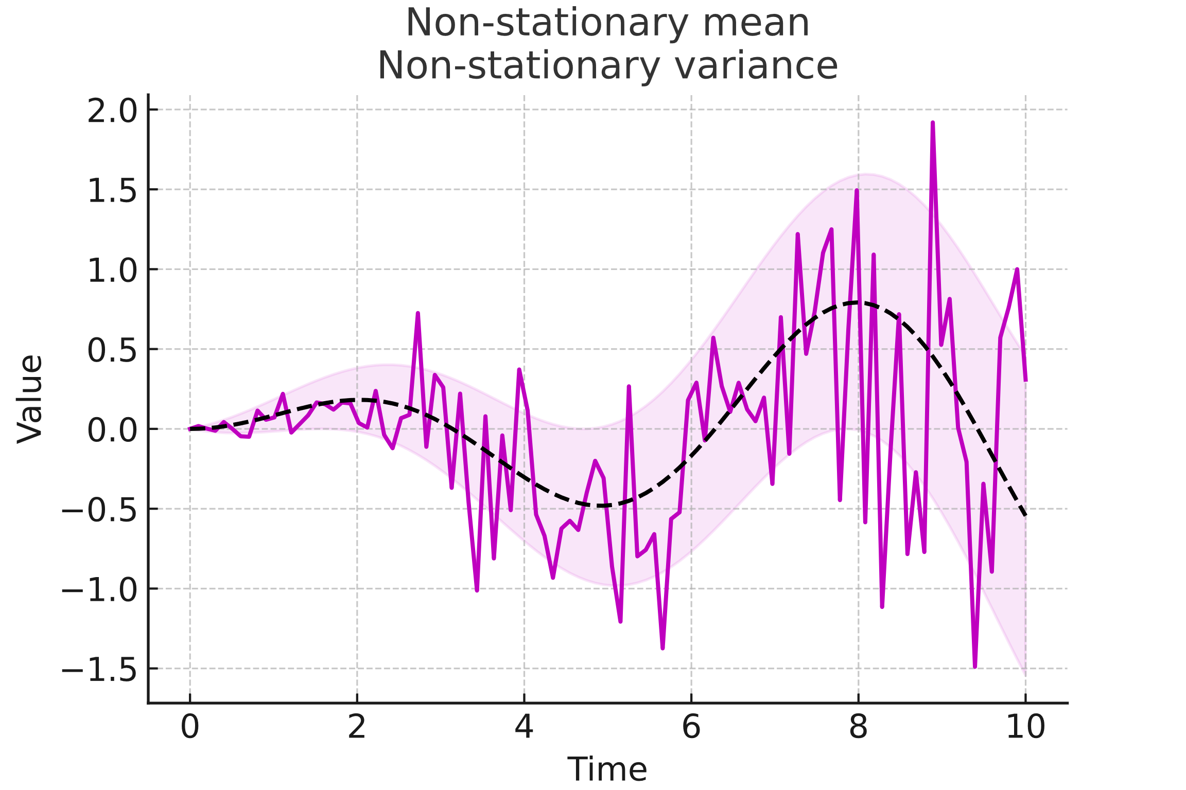
Stationarity

Slide 36
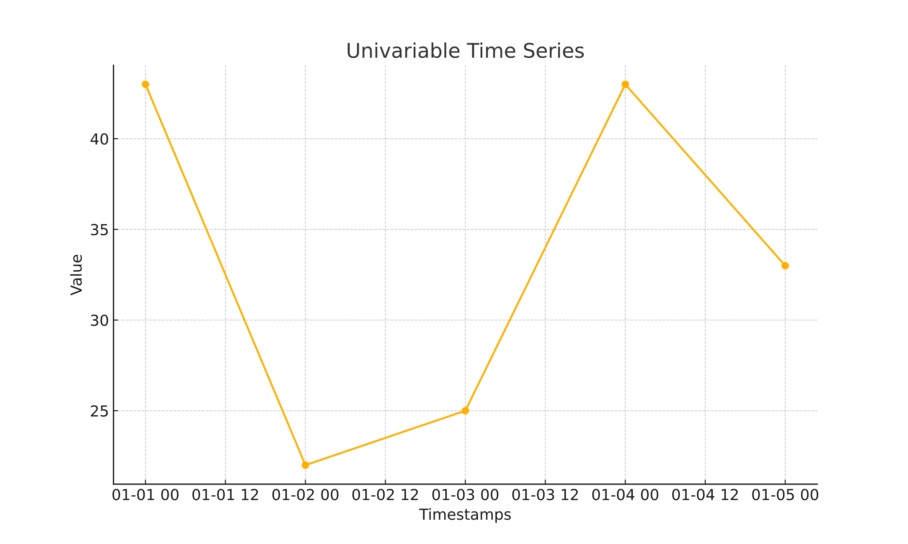
Length
Number of timestamps
Timestamps | Value
2023-01-01 | 43
2023-01-02 | 22
2023-01-03 | 25
2023-01-04 | 43
2023-01-05 | 33
length ?

Slide 37
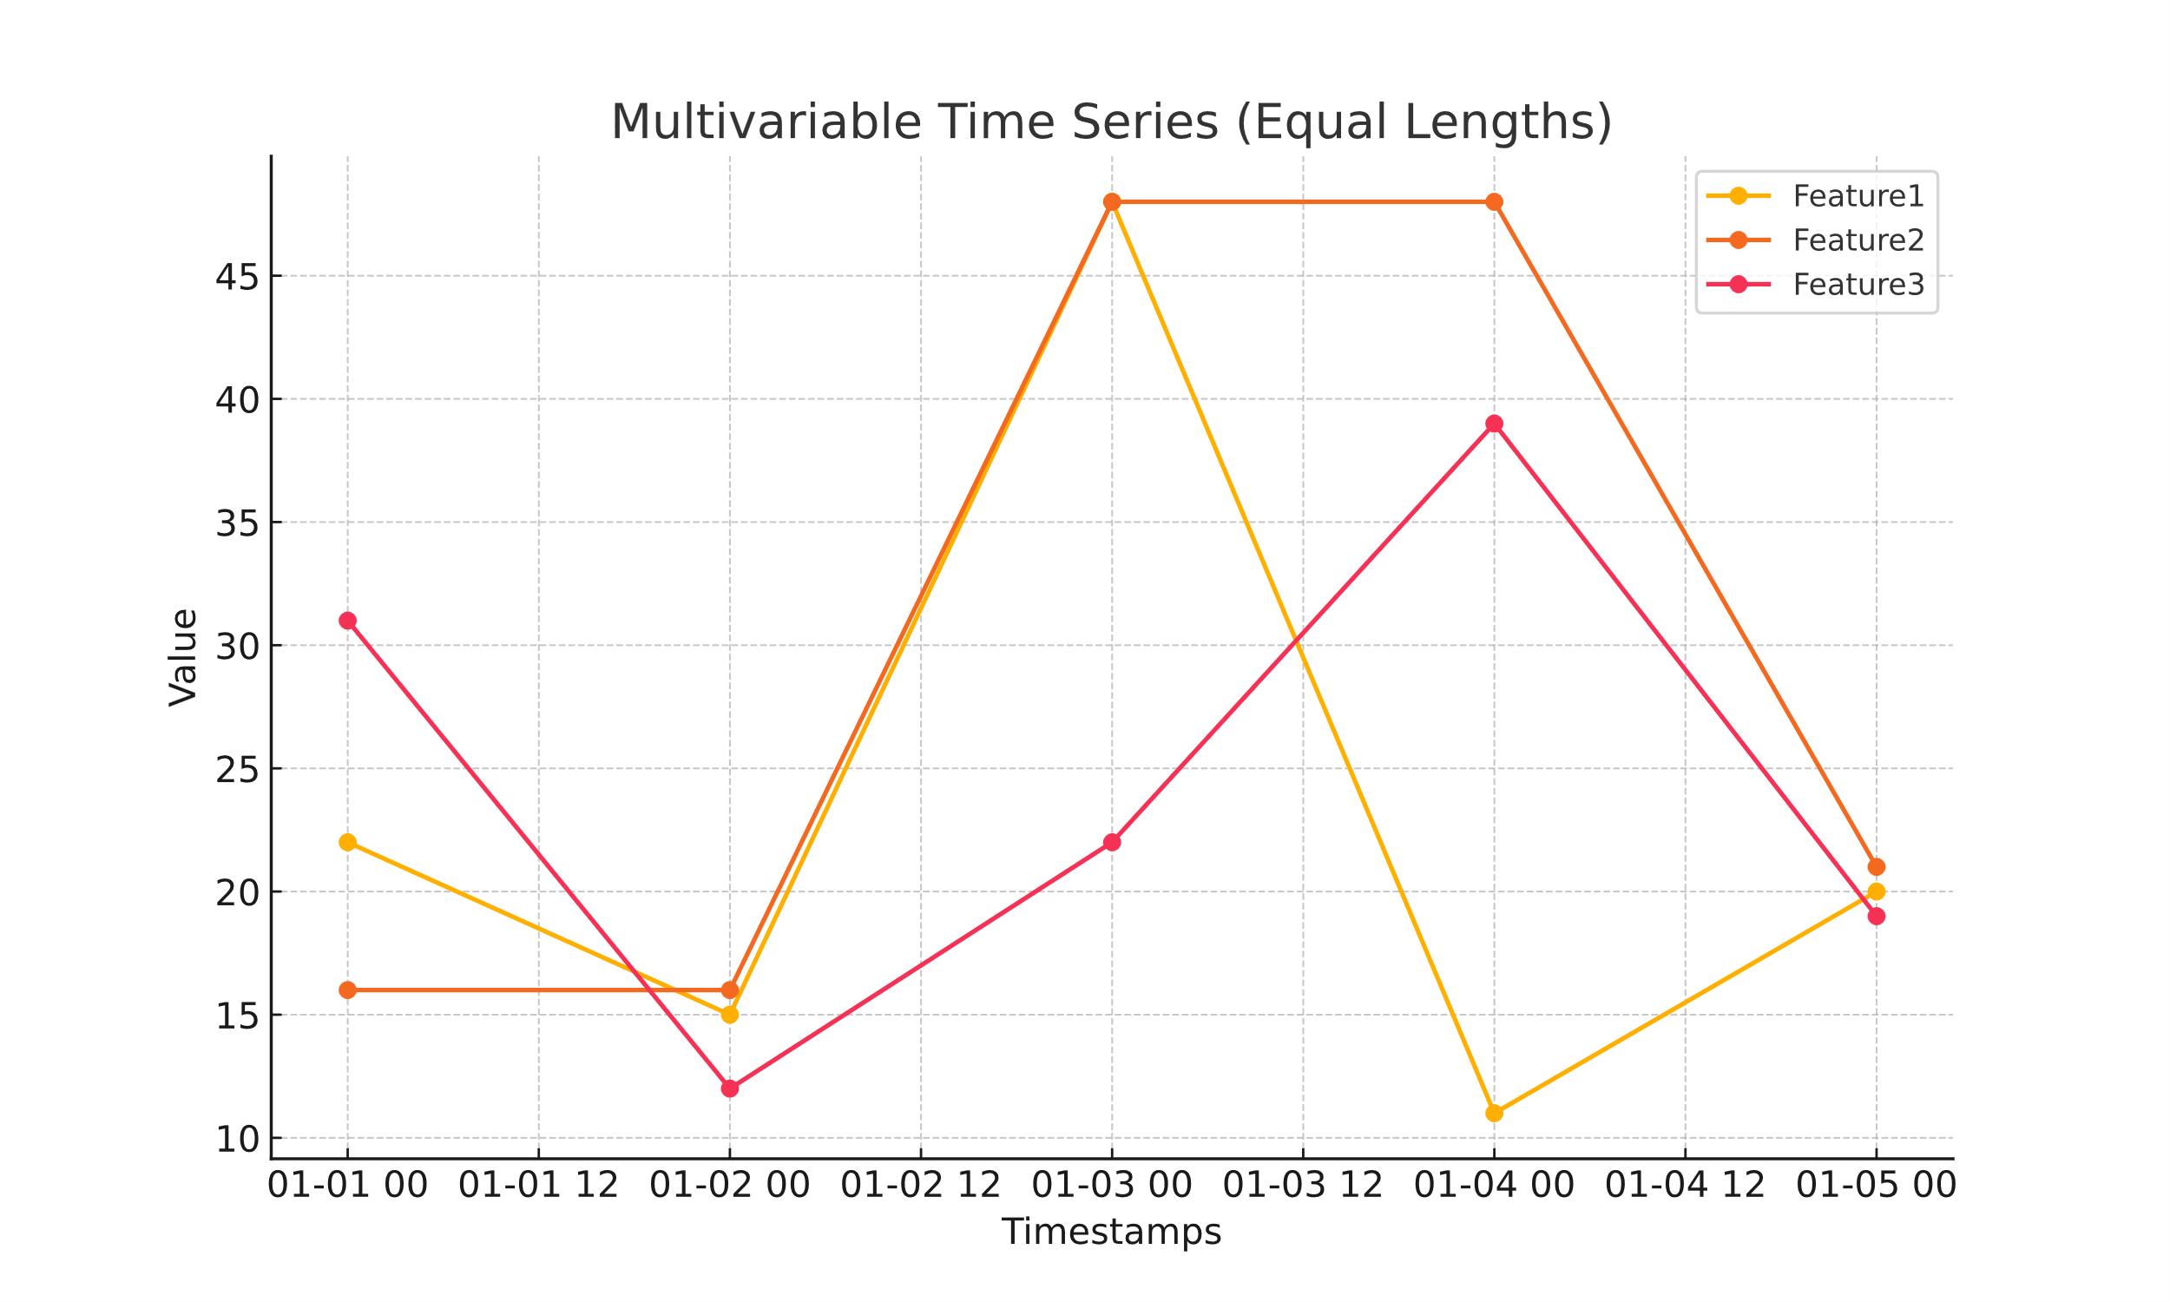
Length
And…
multivariate?
Timestamps | V1 | V2 | V3
2023-01-01 | 16 | 25 | 41
2023-01-02 | 46 | 47 | 42
2023-01-03 | 36 | 47 | 26
2023-01-04 | 40 |  | 42
2023-01-05 | 15 |  | 20
length ?

Slide 38
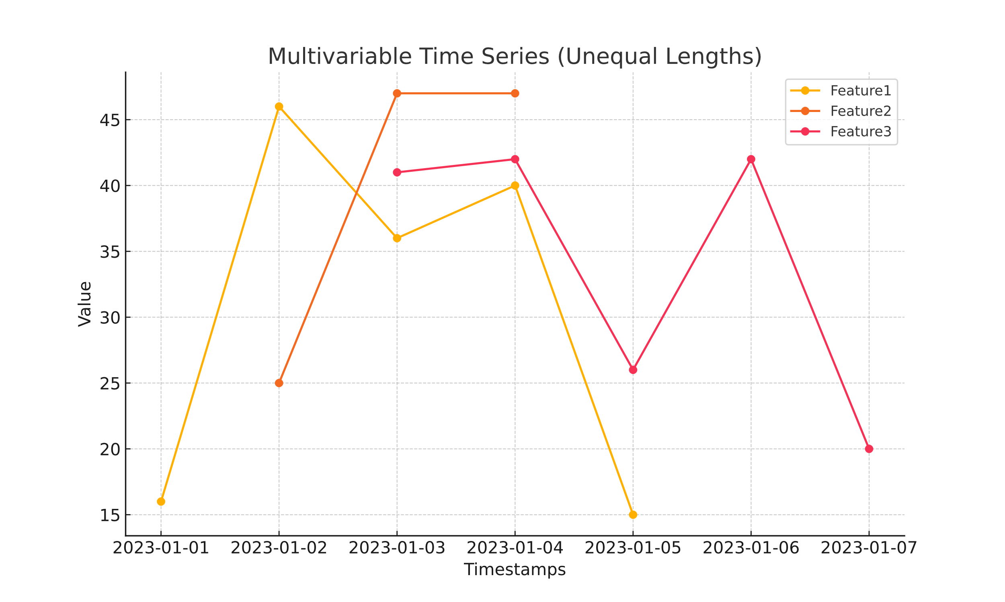
Length
And…
multivariate?
Timestamps | V1 | V2 | V3
2023-01-01 | 22 | 16 | 31
2023-01-02 | 15 | 16 | 12
2023-01-03 | 48 | 48 | 22
2023-01-04 | 11 | 48 | 39
2023-01-05 | 20 | 21 | 19
length ?

Slide 39
Spacing
Time | Available food (grs)
7:00 AM | 100
11:00 AM | 50
03:00 PM | 0
06:30 PM | 100
07:00 PM | 50
11:00 PM | 0
Time | Available food (gr)
7:00 AM | 200
11:00 AM | 150
03:00 PM | 100
07:00 PM | 50
11:00 PM | 0
4h
4h
4h
4h
3h 30 min
4h
30 min
4h
4h
Evenly spaced
Non evenly spaced

Slide 40
Papel y boli
?

Slide 41
Papel y boli
Parte 1:
Pregunta evaluable: longitud del dataset del gato
Dibujar dos series temporales univariables (una estacionaria y otra no)
Pregunta evaluable: longitud de la serie temporal
Pregunta evaluable: estacionareidad
Dibujar serie temporal multivariable con las mismas longitudes
Dibujar serie temporal multivariable con distintas longitudes

Slide 42
Classical (additive) decomposition
x(t) = T(t) + S(t) + I (t)
x(t): time series “x” data at index position “t”
T: trend component.
S: seasonality component
I: Irregular/noise/random component

Slide 43
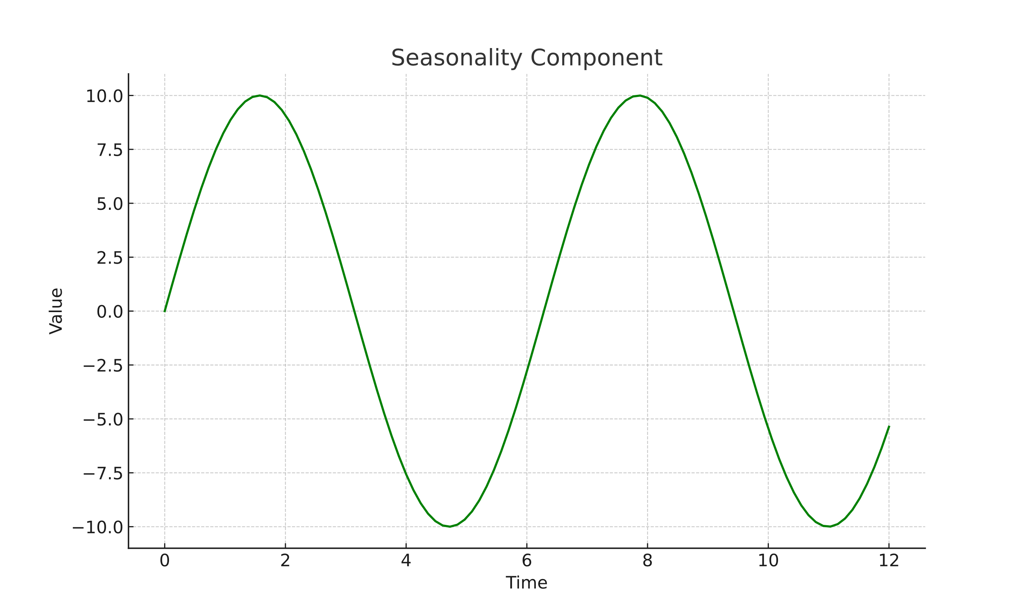
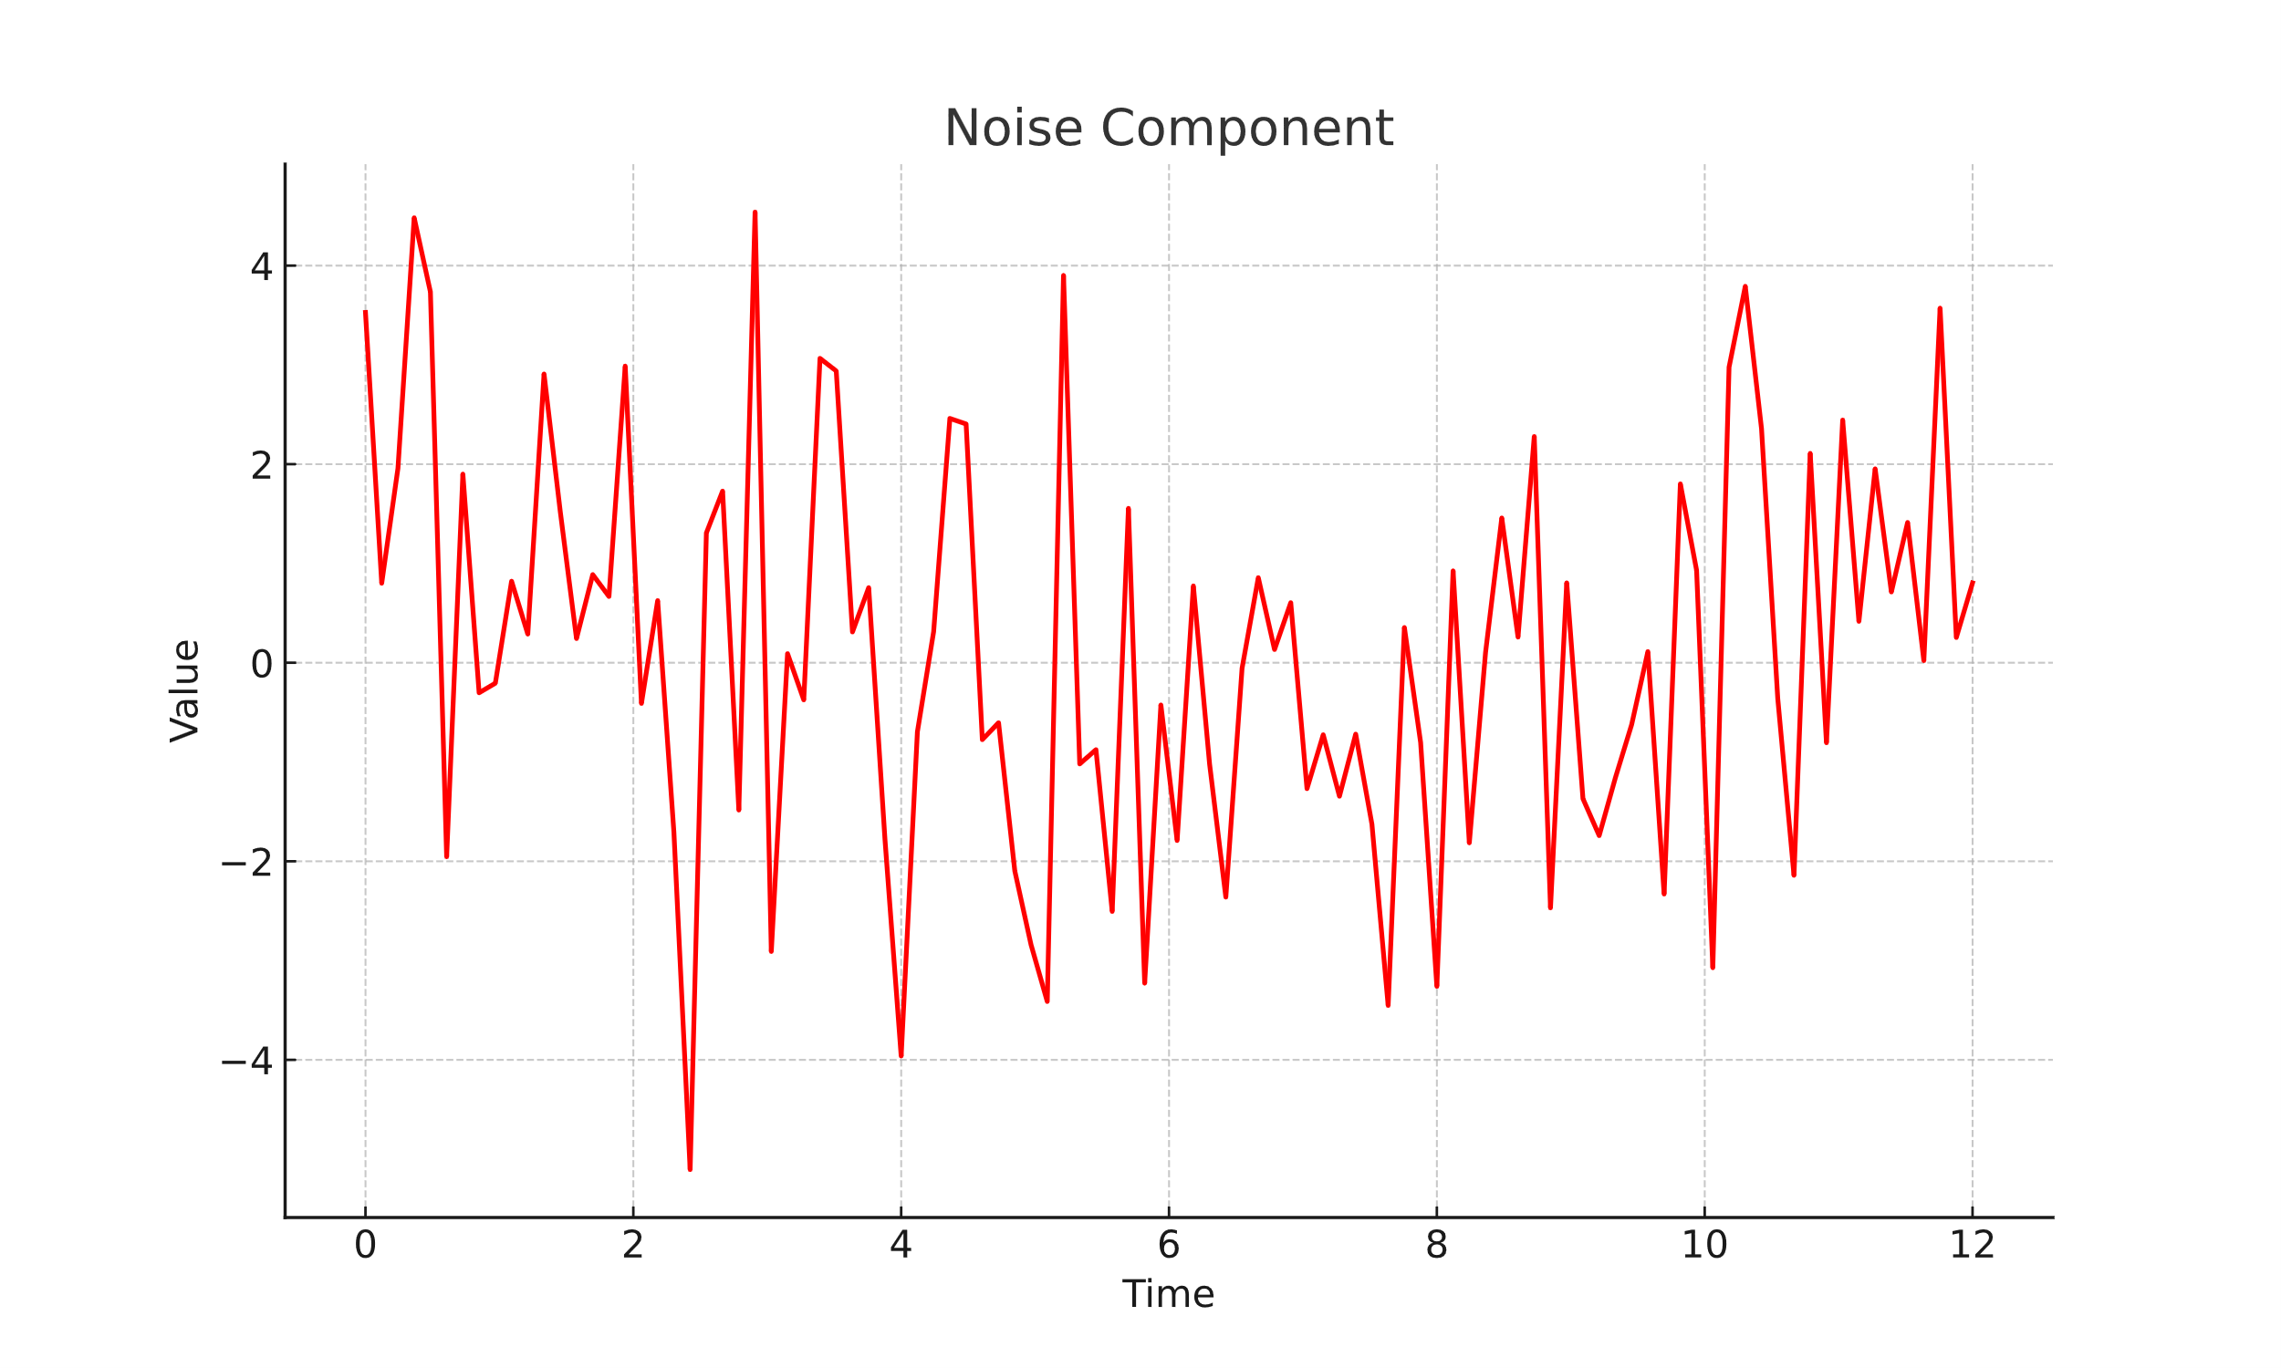
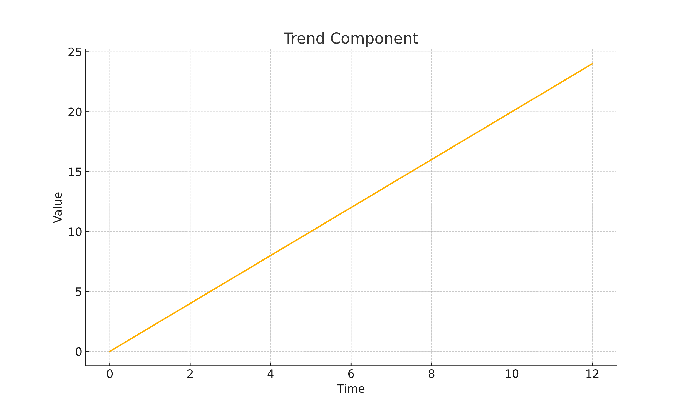
Classical (additive) decomposition
+
+
T
S
I

Slide 44
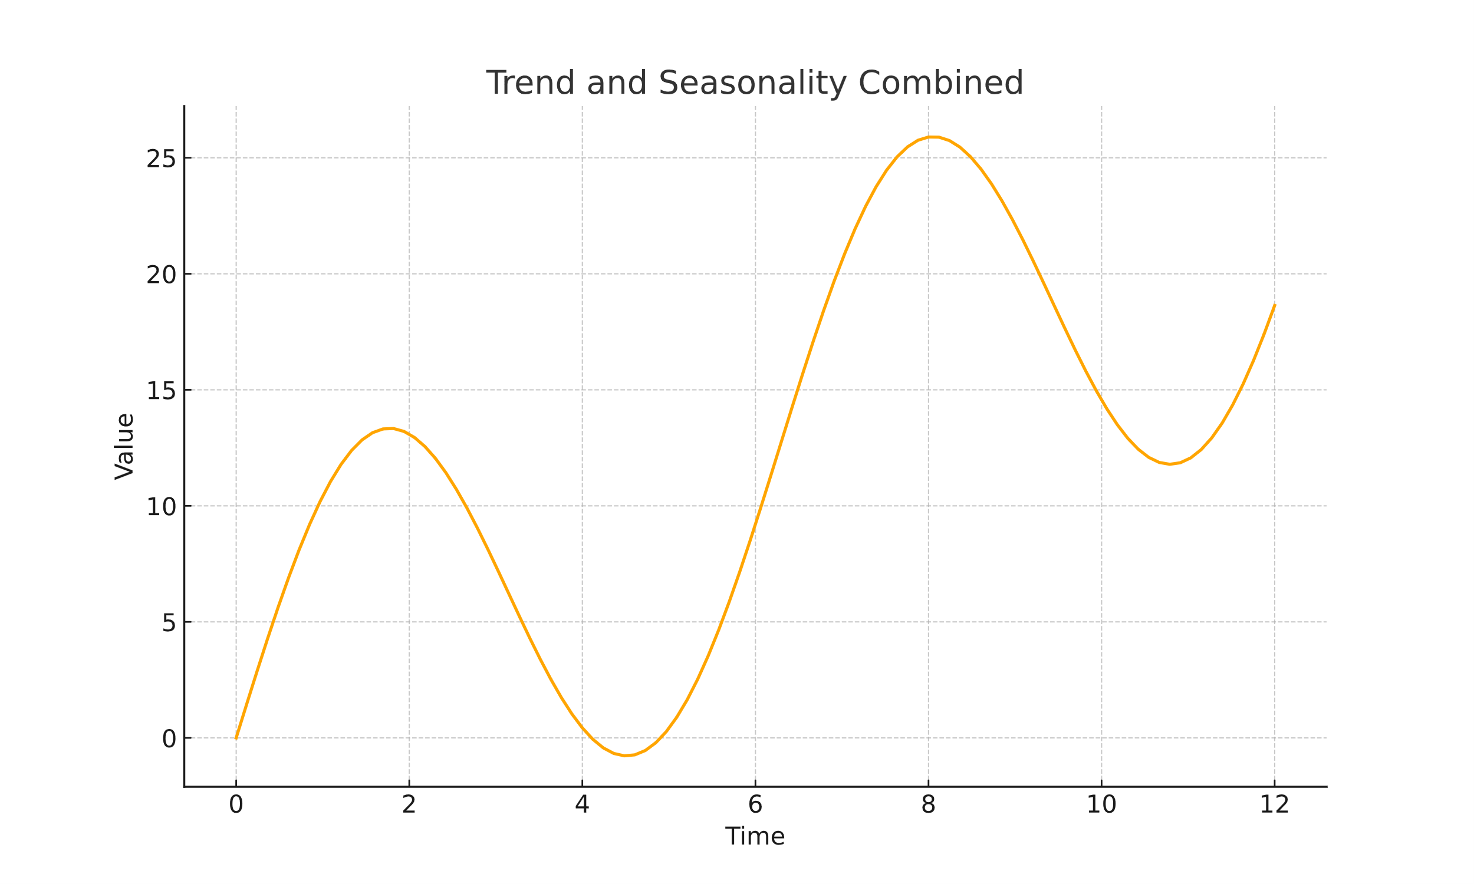
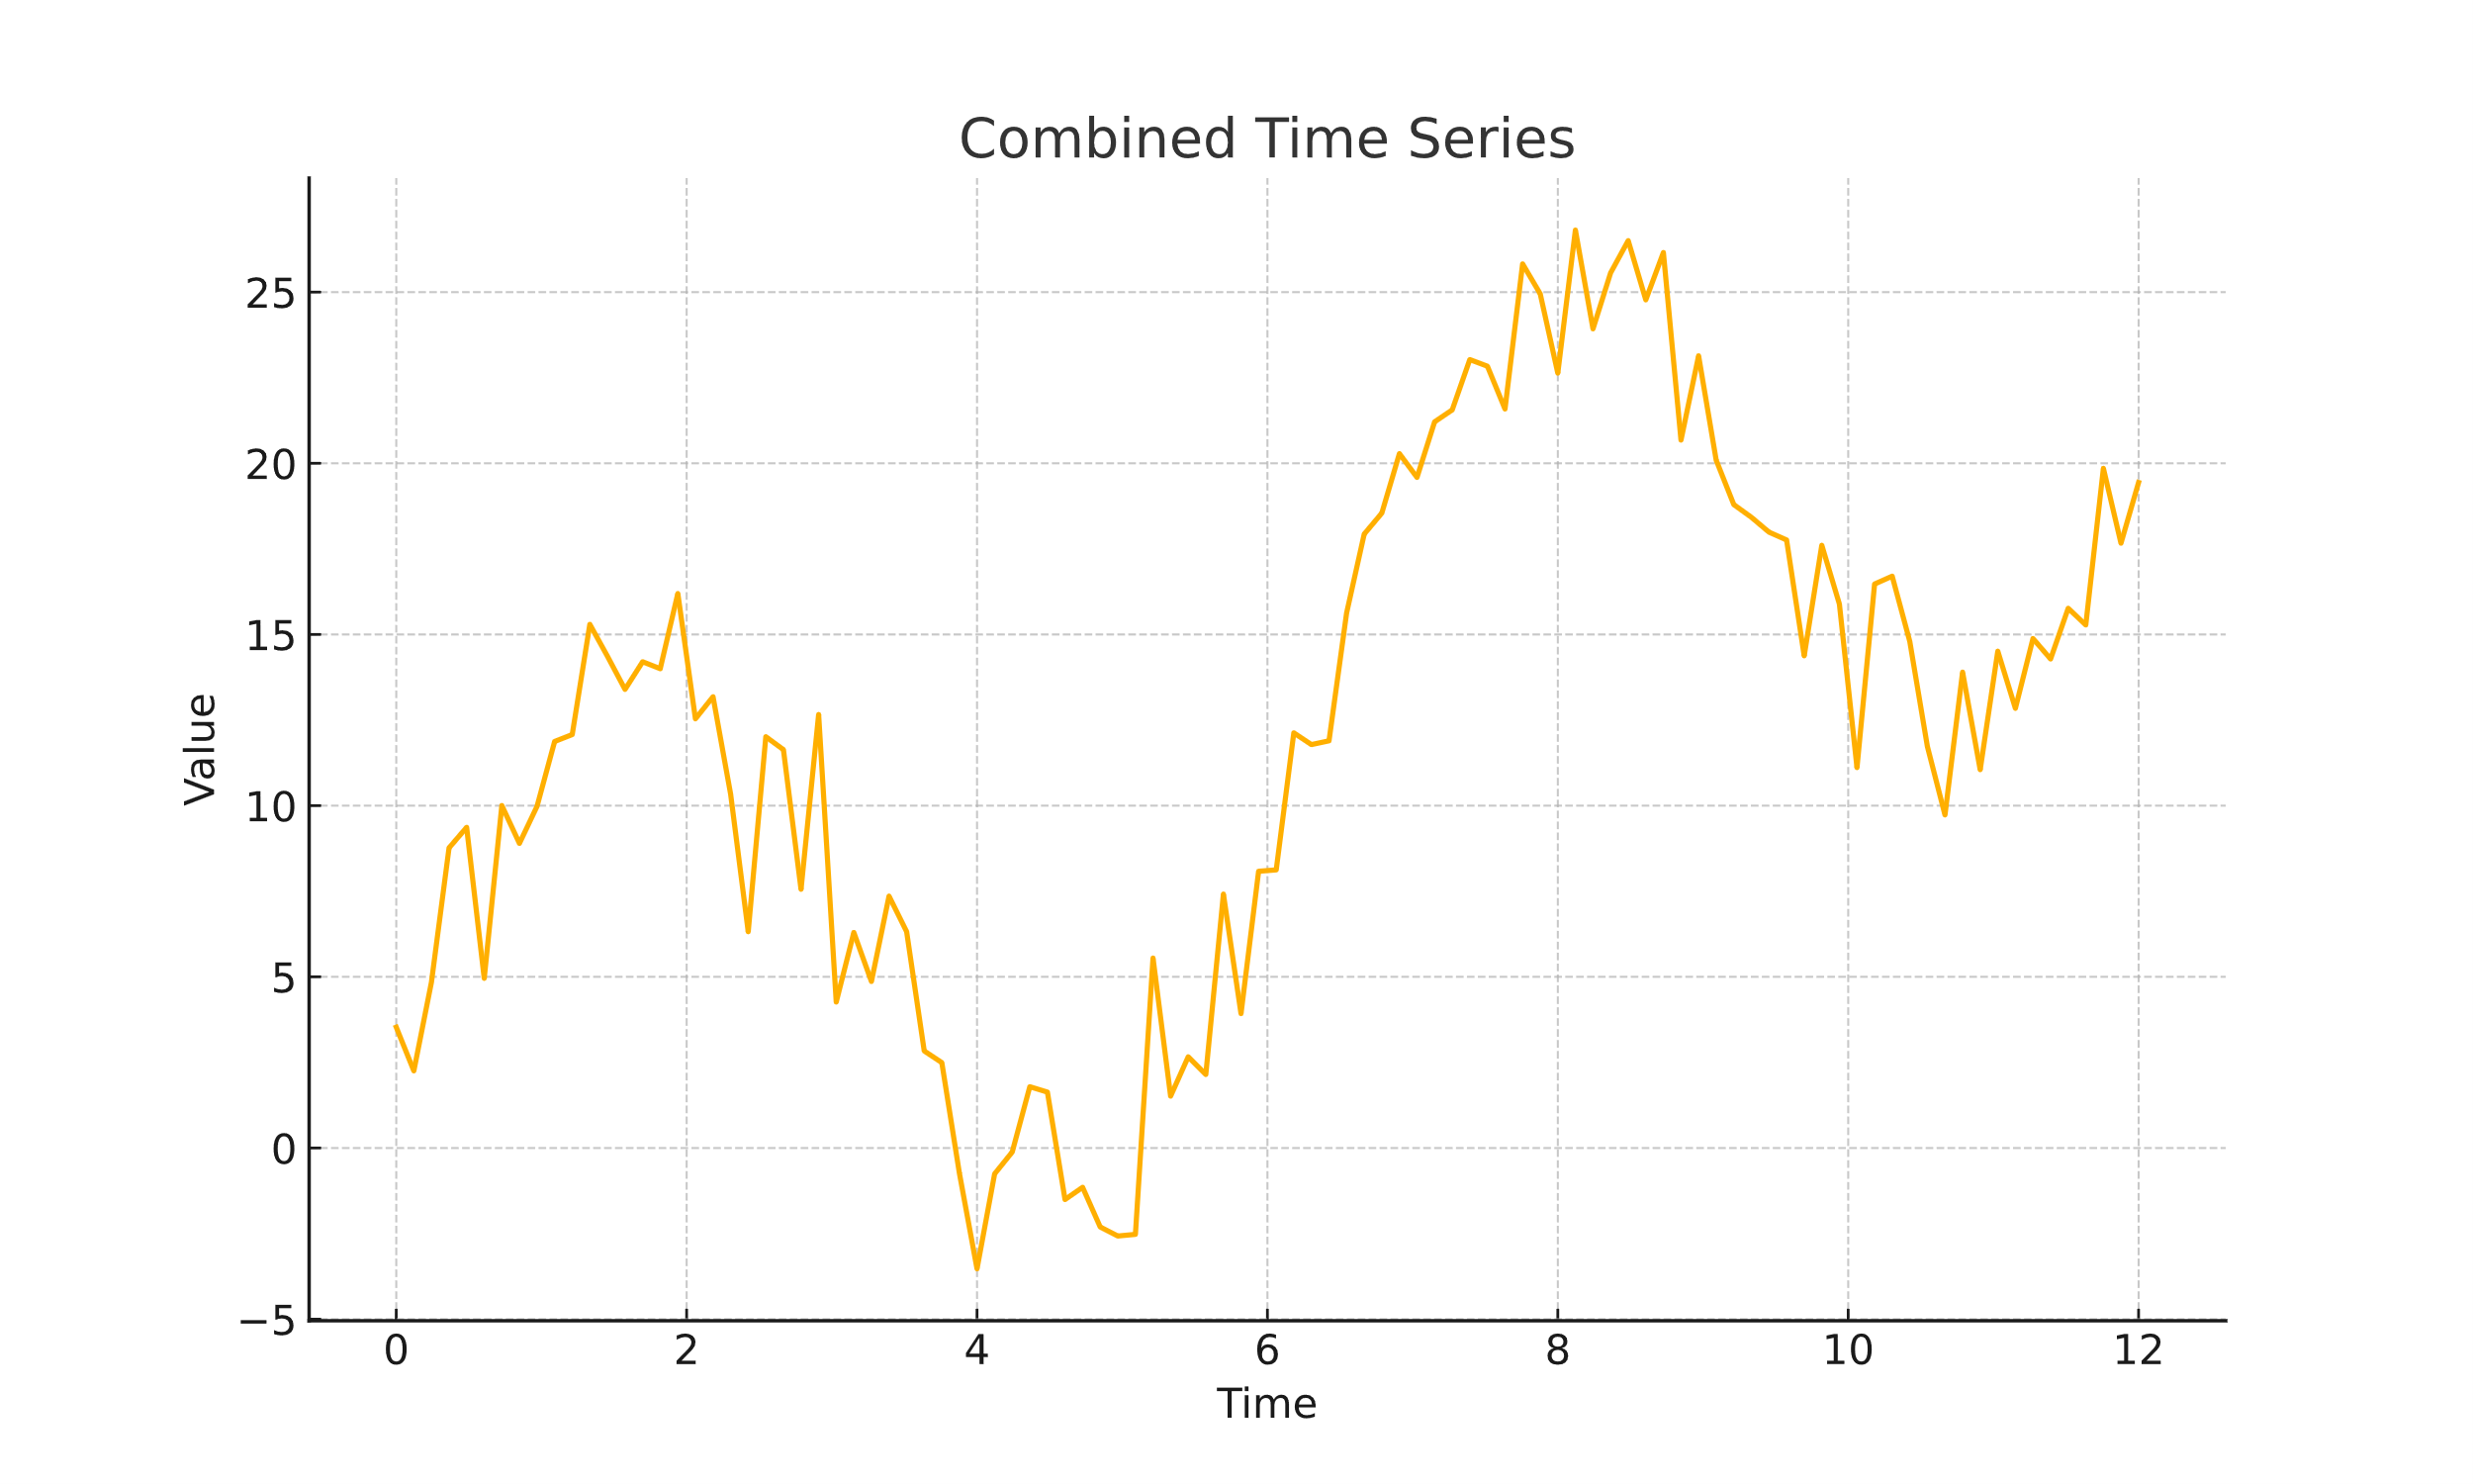
Classical (additive) decomposition
+
=
T+S
I
X(t)

Slide 45
Google Collab
01 – Part 1
?

Slide 46
Google Collab
Dar un código para generar series temporales con la descomposición clásica aditiva y pedir: (todas de largo 40)
Generar una serie temporal dada y explicar su estacionariedad o no.
Generar una serie temporal con:
Tendencia ascendente y sin ruido, con seasonalidad repetida cada 10 índices
Estacionaria respecto a la media

Slide 47
Summary
Summary of the lesson

Slide 48
What this we just learned?
What is a time series
Where can we get time series from
Types of time series
The problem of evenly/non-evenly distribution
Lenth
Classical (additive decomposition): trend, seasonality, irregular/noise

Slide 49
What is the next step?
Given a time series…
How can I know it length, seasonality, etc.?

Slide 50
To be continued…
Questions? mi.santamaria@upm.es

Slide 51
Deep Learning para series temporales
Part I
Introduction

